Slide 1

ML Ontology solution for Blood Donation System
Final Year Project

Slide 2
Department of Computer Sciences
FYP - Details
Guided By:
Ma’am Sana Rizwan
FYP Serial No:
FA22SE13

Slide 3
Our Team
Akash Ur Rehman
FA19-BSE-112
Muhammad Abu Hurairah
FA19-BSE- 033
Muhammad Salman Ahmed
FA19-BSE- 098

Slide 4
Introduction
Implementation of the Blood Donation System through ML & Ontology.
Automation of the Manual system to decrease the workload of Blood Banks.
Using Ontological Concepts with Machine Learning as it improves the data quality for training the datasets.
A motto of arranging the blood on time to save Precious Lives.
Welfare For ALL!

Slide 5

Objectives & Scope
People can easily access where they will find the blood they are required
Donor can make appointment
The user can make a request for the blood at any time
Integrating Labs for adding the blood report details of
registered Users.
All the Blood donation Centers of Lahore city can
register them on the Website

Slide 6

Benefits
Helping the People in Critical circumstances.
No Hassle regarding the Donations or Blood Queries because of automation of the system.
Book and Appointment while being at your places.
Get Your Appointment Details through the website.
Helping to Identify the eligibility for the donation.
Connect with the donor if stock is not available.
Save Time. Save Lives!

Slide 7
Functional Requirements
Login
Registration
Make the request for Blood
Donate Blood
Check Eligibility of User For Blood Donation
View Blood Donation Centers
Generate Appointment Report
Display User Profile

Slide 8
Functional Requirements (Cont)
View Blood Requests
Update Personal Information
Delete Personal Information
Get User Feedback
Add User Information
Generate Report of Blood Stocks
Update Blood Stock

Slide 9
Functional Requirements (Cont)
Download Weekly/Monthly Appointment Reports
Manage NGO’s or Blood Donation Centers
Add News
Handling Blood Request
Managing Enquiries
Managing User’s Personal Information
Managing Campaigns
Managing Donor List
Manage Sponsors
Manage Financial Donations
Manage Job Posts
Managing Frequently asked Questions

Slide 10
Main Consoles
01
02
Admin
User
03
04
Blood Donation
Center
Labs

Slide 11
Related Work
Haemoglobinopathies in India: estimates of blood requirements and treatment costs for the decade 2017-2026,”
Journal of community genetics, vol. 11, no. June,11, pp. 39-45, 2020.
In this study, it is explore that collecting blood from the donor and making it available for different types of patients (thalassemia patients, cancer patients, etc.). Now, Pakistan Health Organizations (PHO) is providing facilities to patients to save their lives in any emergency.

Slide 12
Related Work
“Profiling blood donors in Egypt: A neural network analysis, Expert system with Applications “
vol. 36, no. 2009, pp. 5031-5038, 2009.
Blood is needed in emergency as well as routine operations like medical disease (cancer), heart bypass, etc. Different models such as Multi-layer perceptron neural network (MLP) and probabilistic neural network (PNN) models are used for predicting the values.

Slide 13
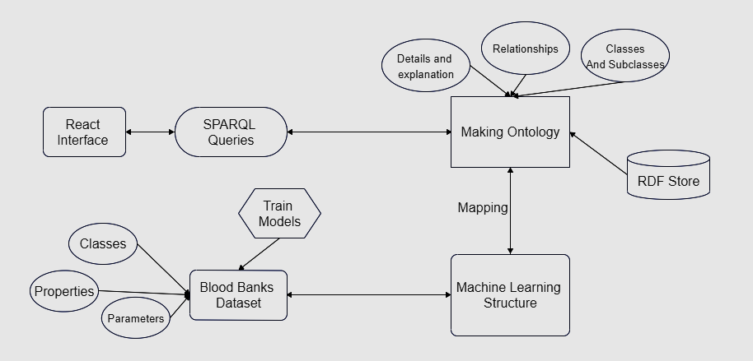
System Architecture Diagram

Slide 14
Tools, Languages and Editors
Tools
Languages
React
Protégé
NodeJS
Express
MongoDB
Python
Ontology
Java Spring
HTML
CSS
JavaScript
Sparql
Web Ontology language
Python
ReactJS
Editors
Visual Studio Code (VS Code)

Slide 15
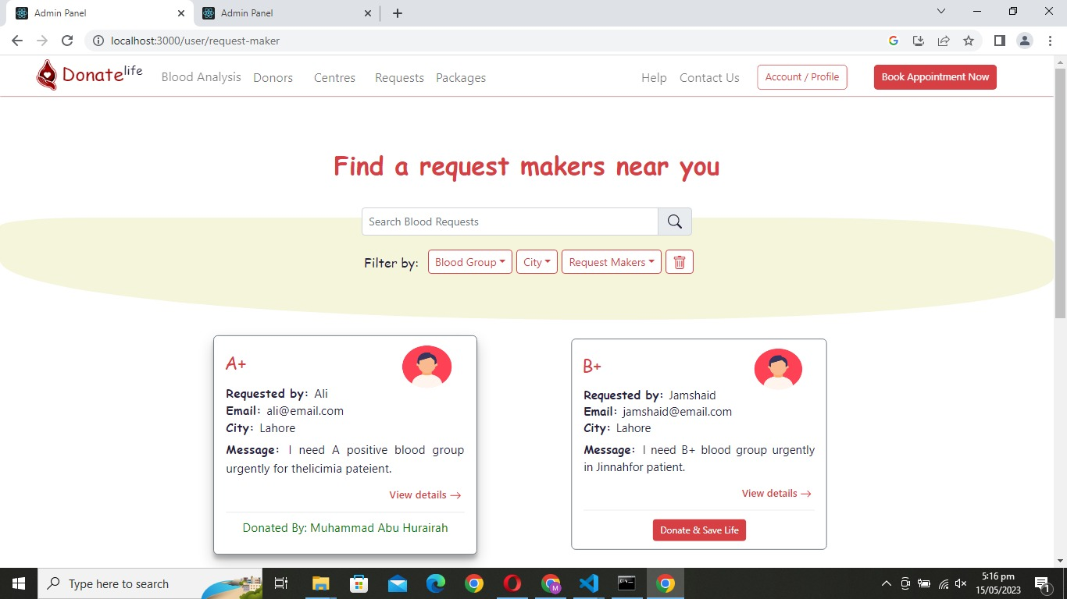
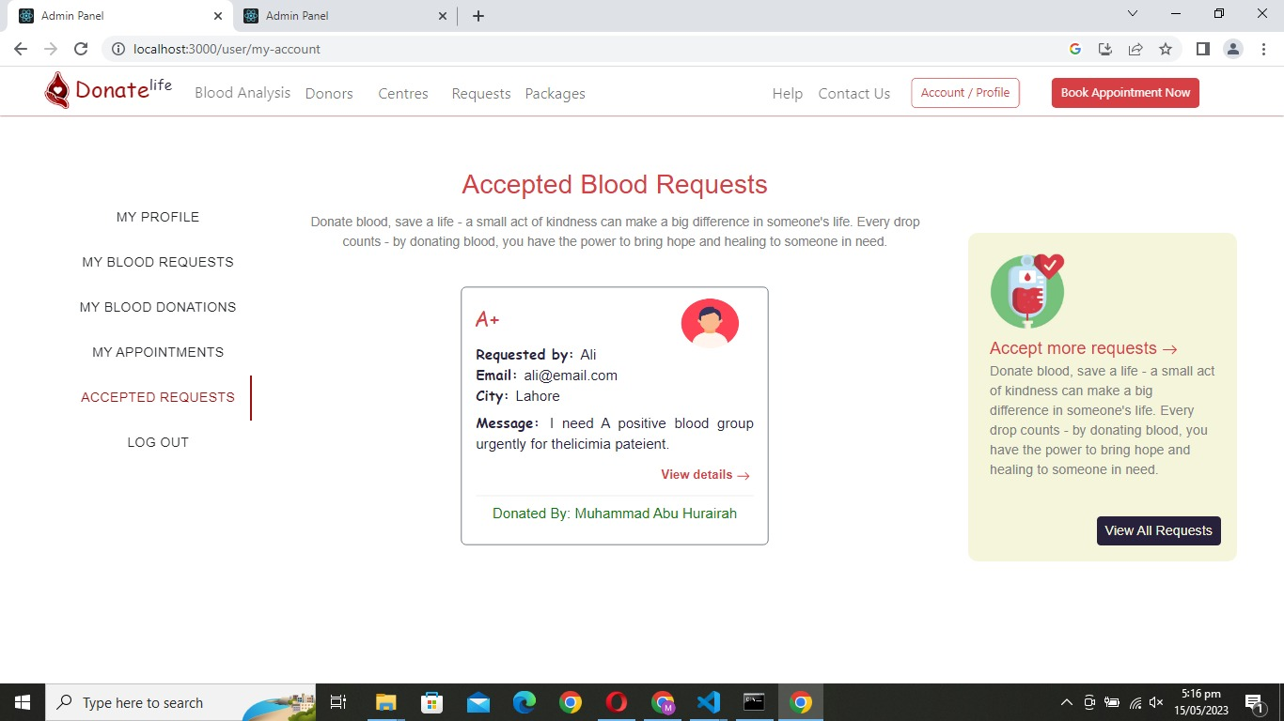
High Fidelity Prototypes
User Panel

Slide 16
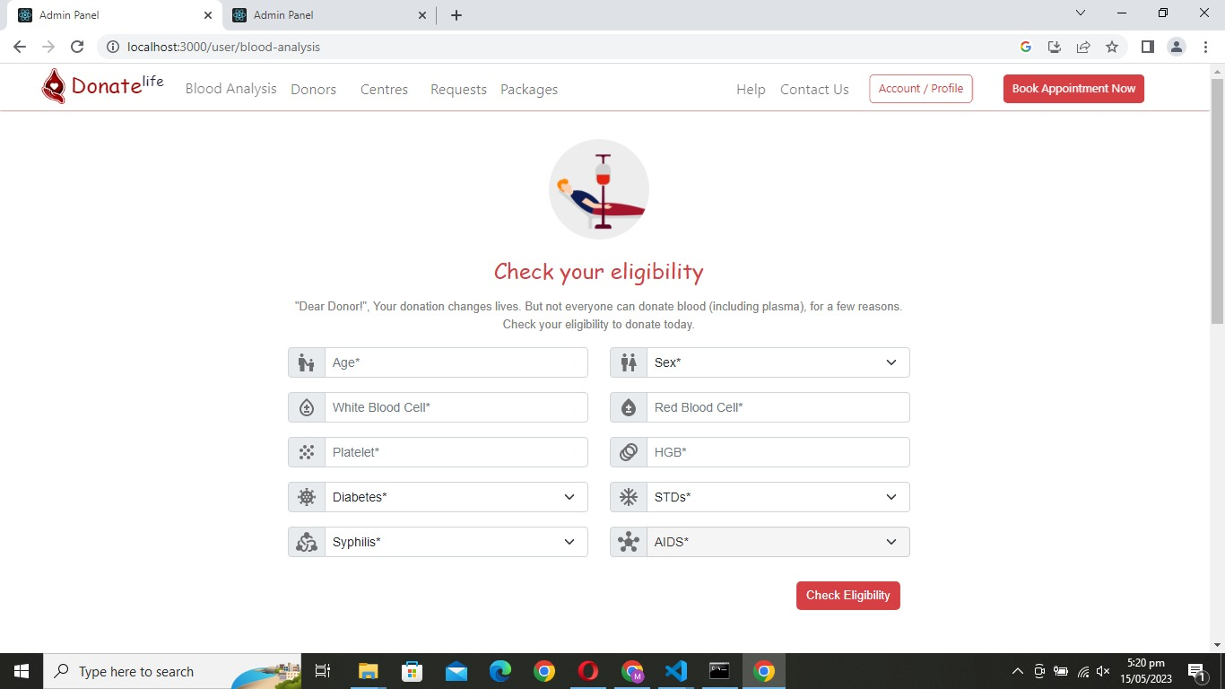
High Fidelity Prototypes
User Panel

Slide 17
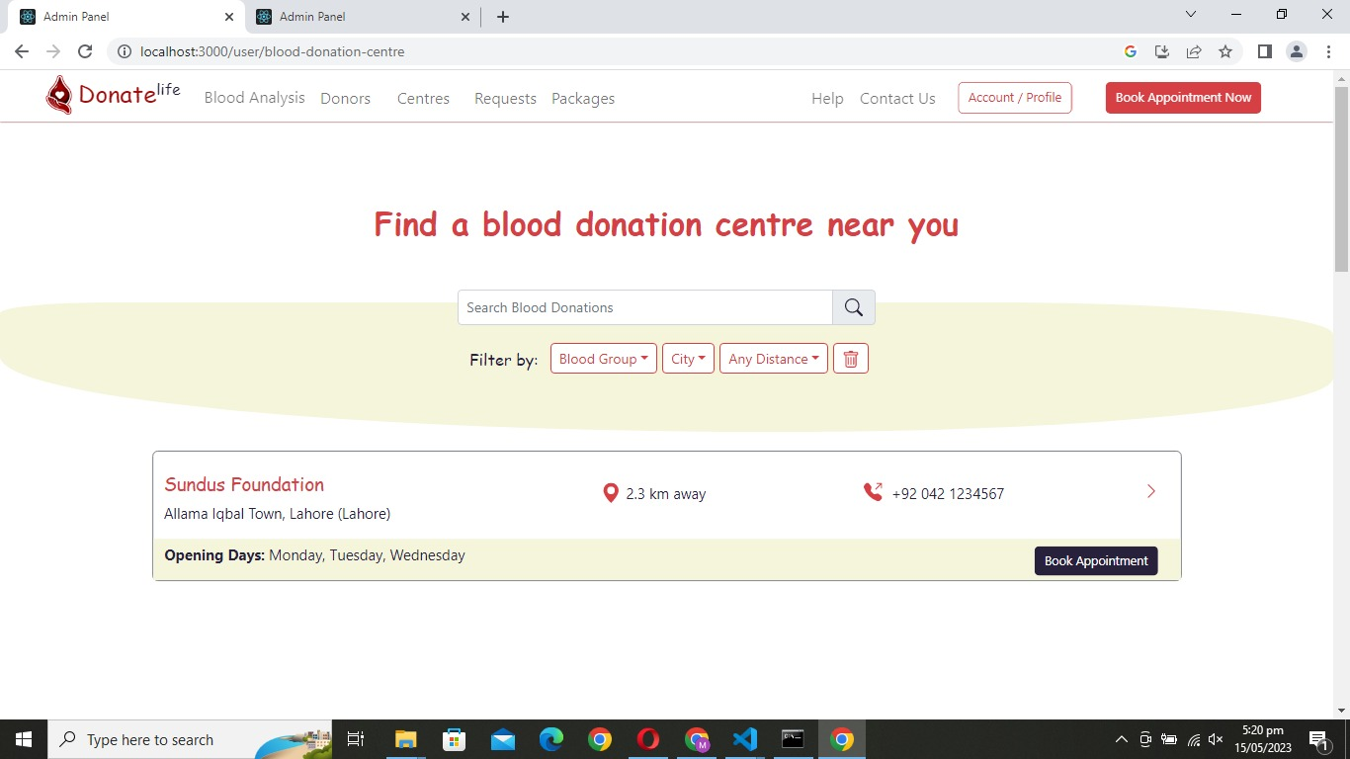
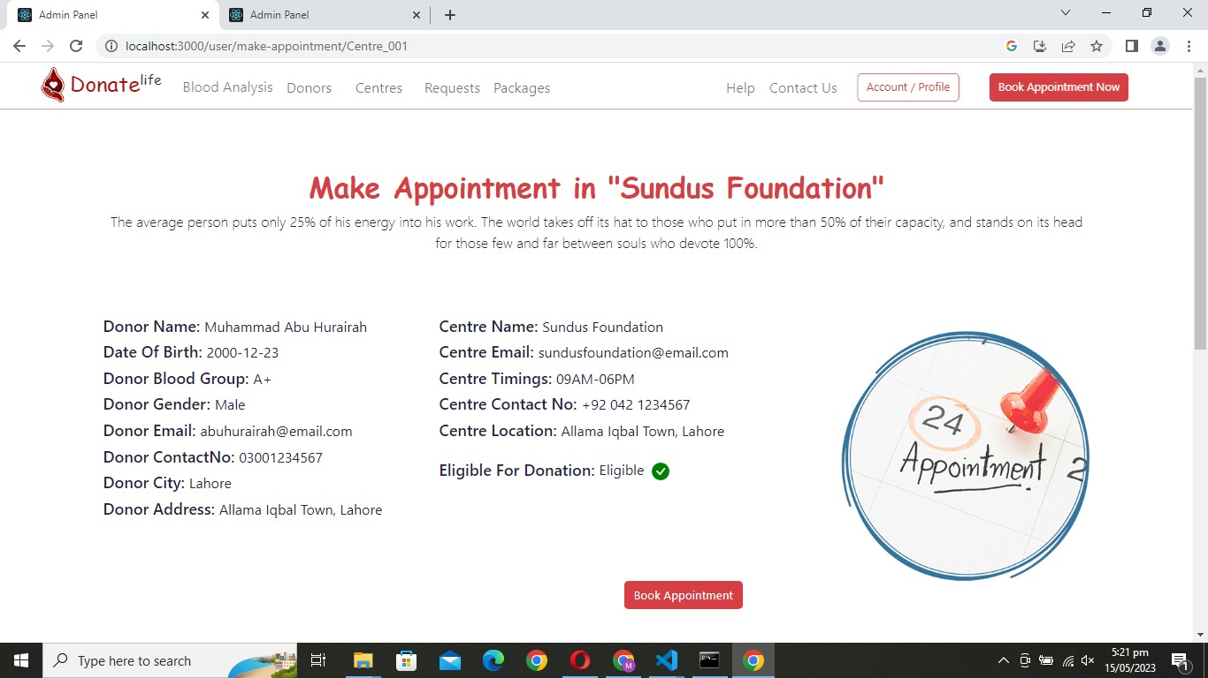
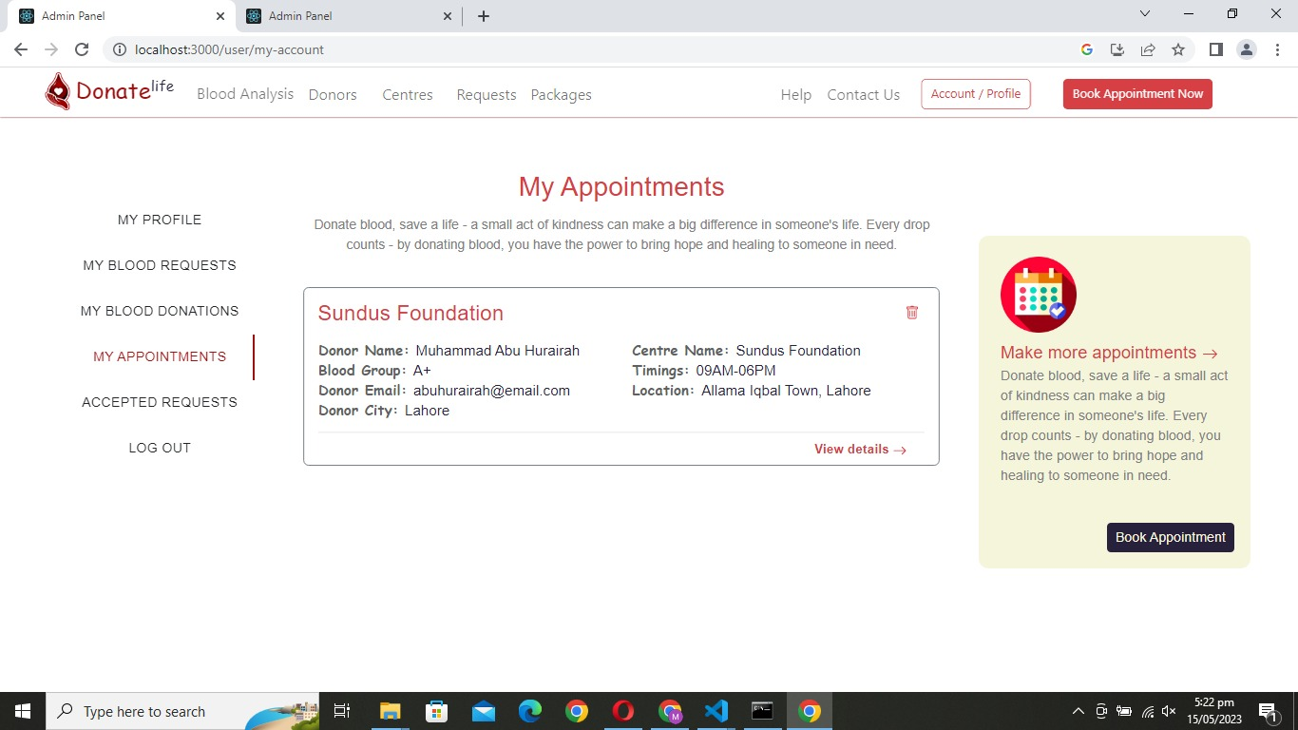
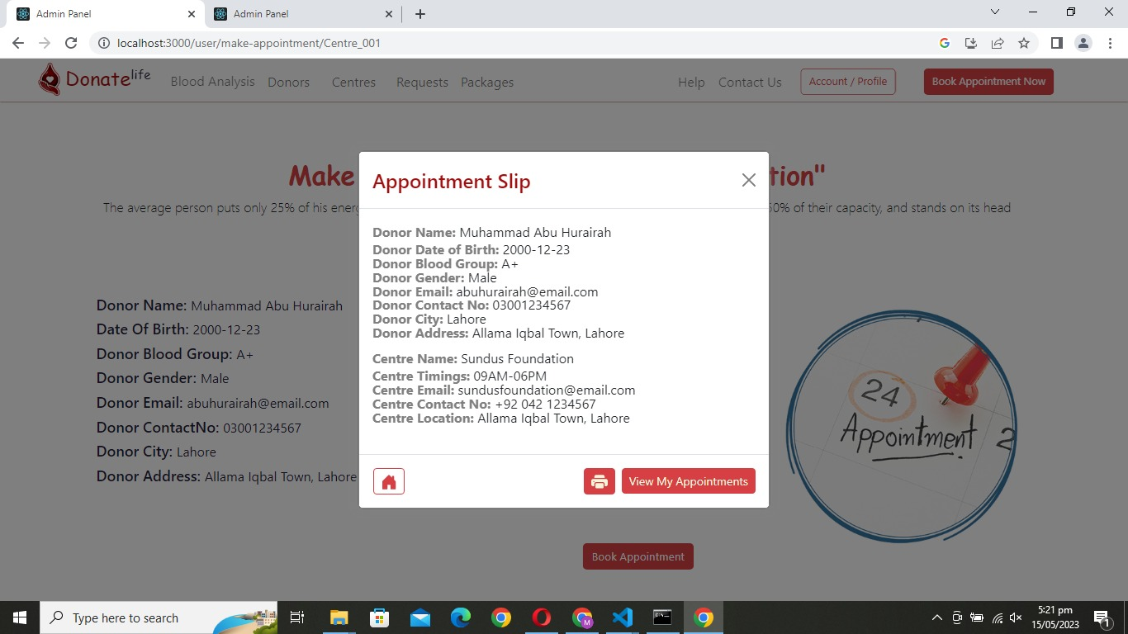
High Fidelity Prototypes
User Panel

Slide 18
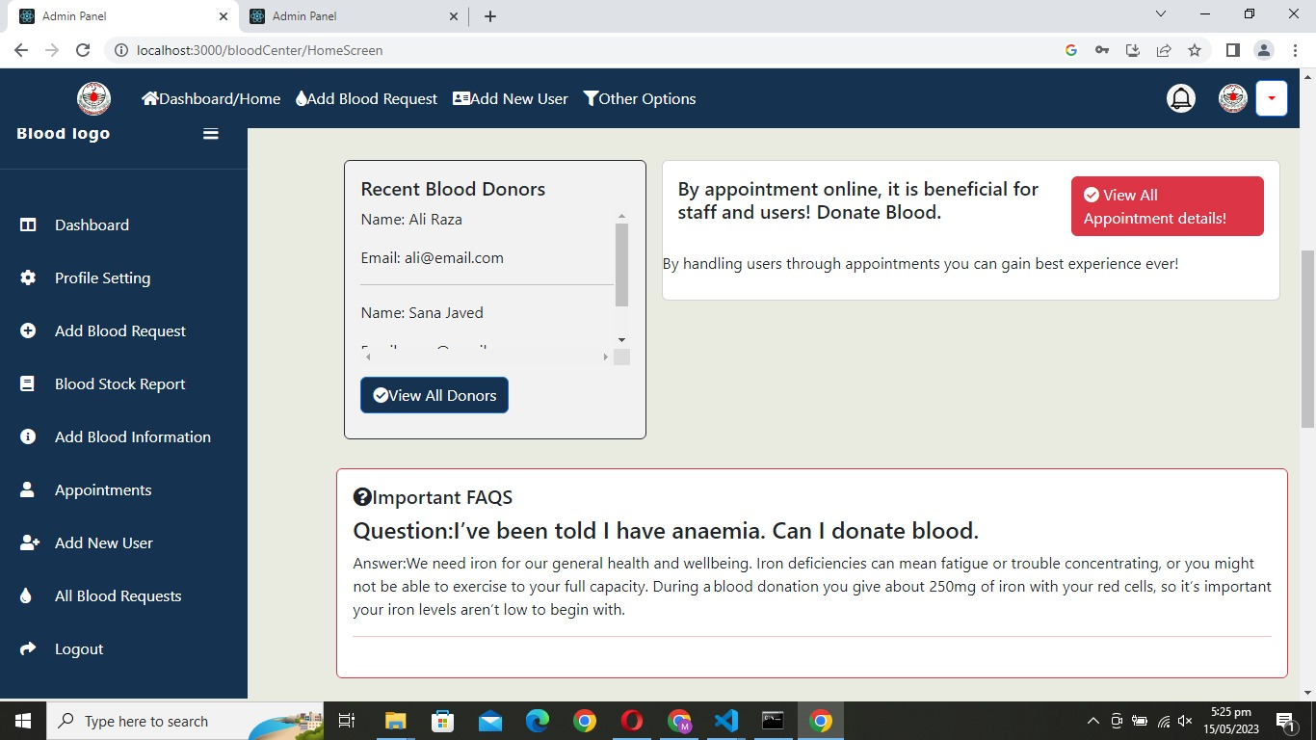
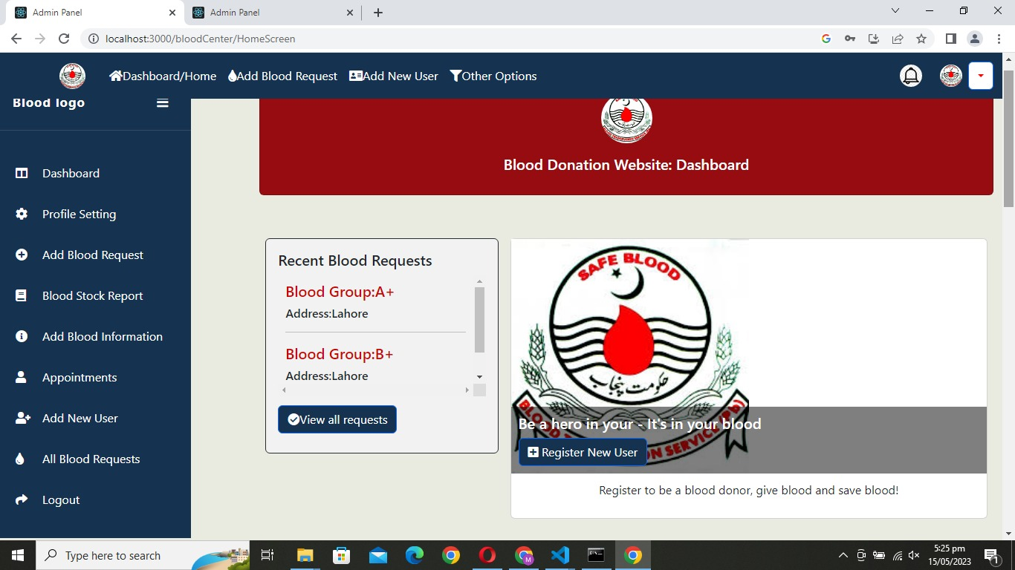
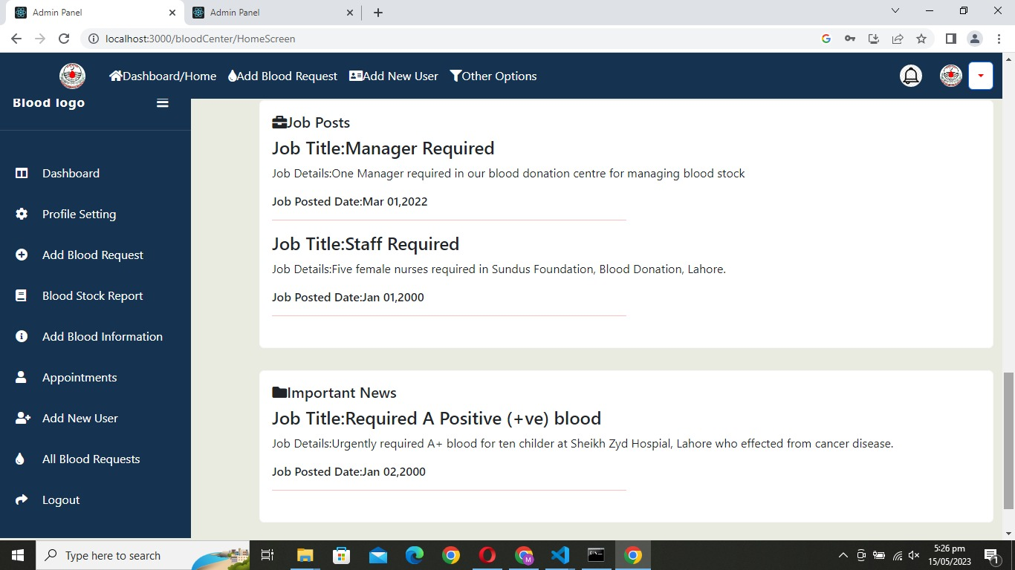
High Fidelity Prototypes
Blood Donation Centre Panel

Slide 19
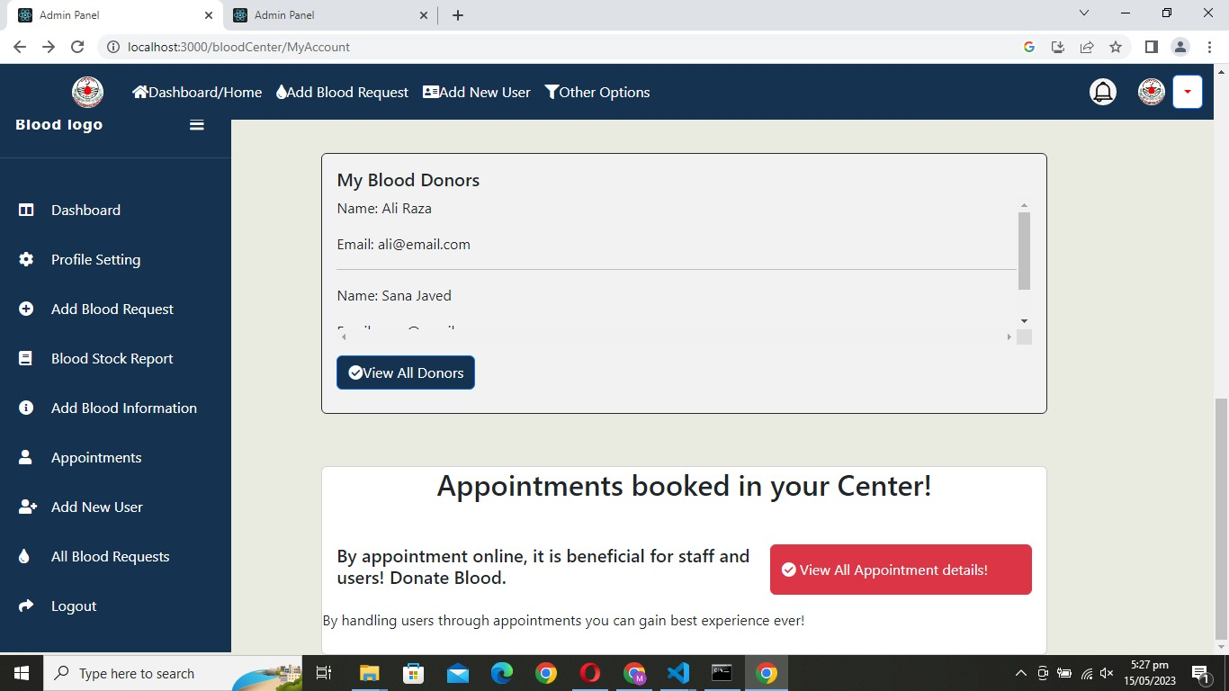
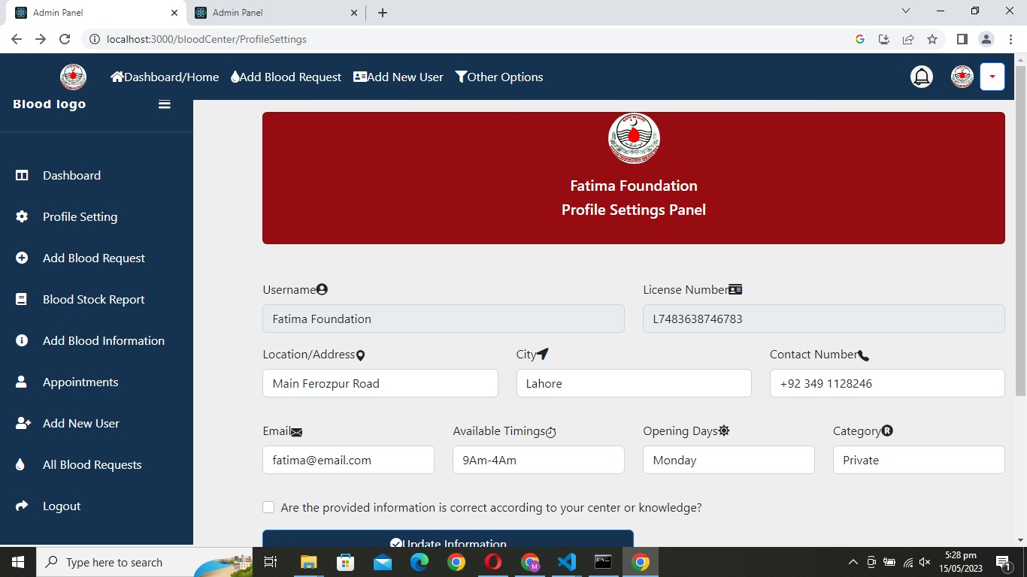
High Fidelity Prototypes
Blood Donation Centre Panel

Slide 20
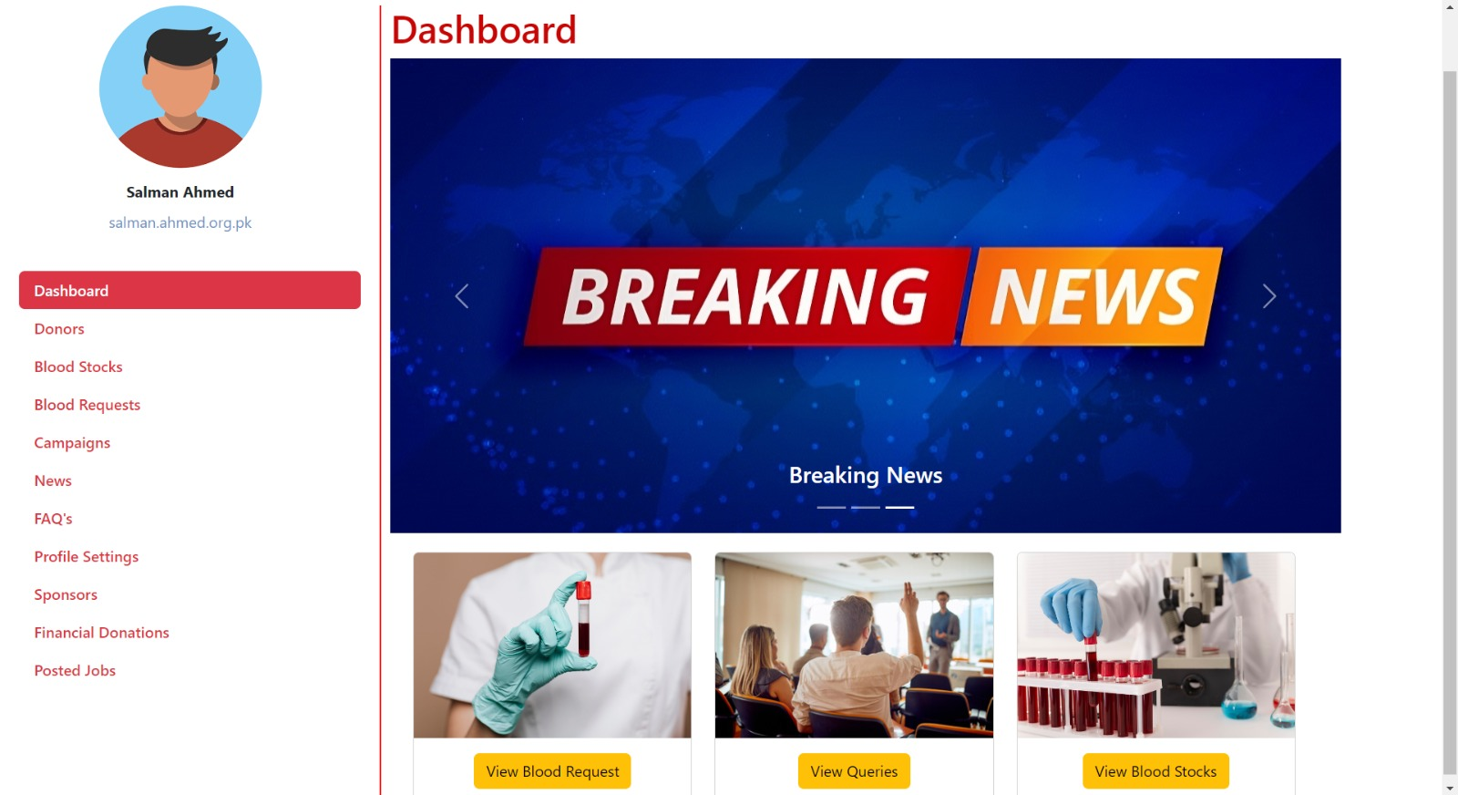
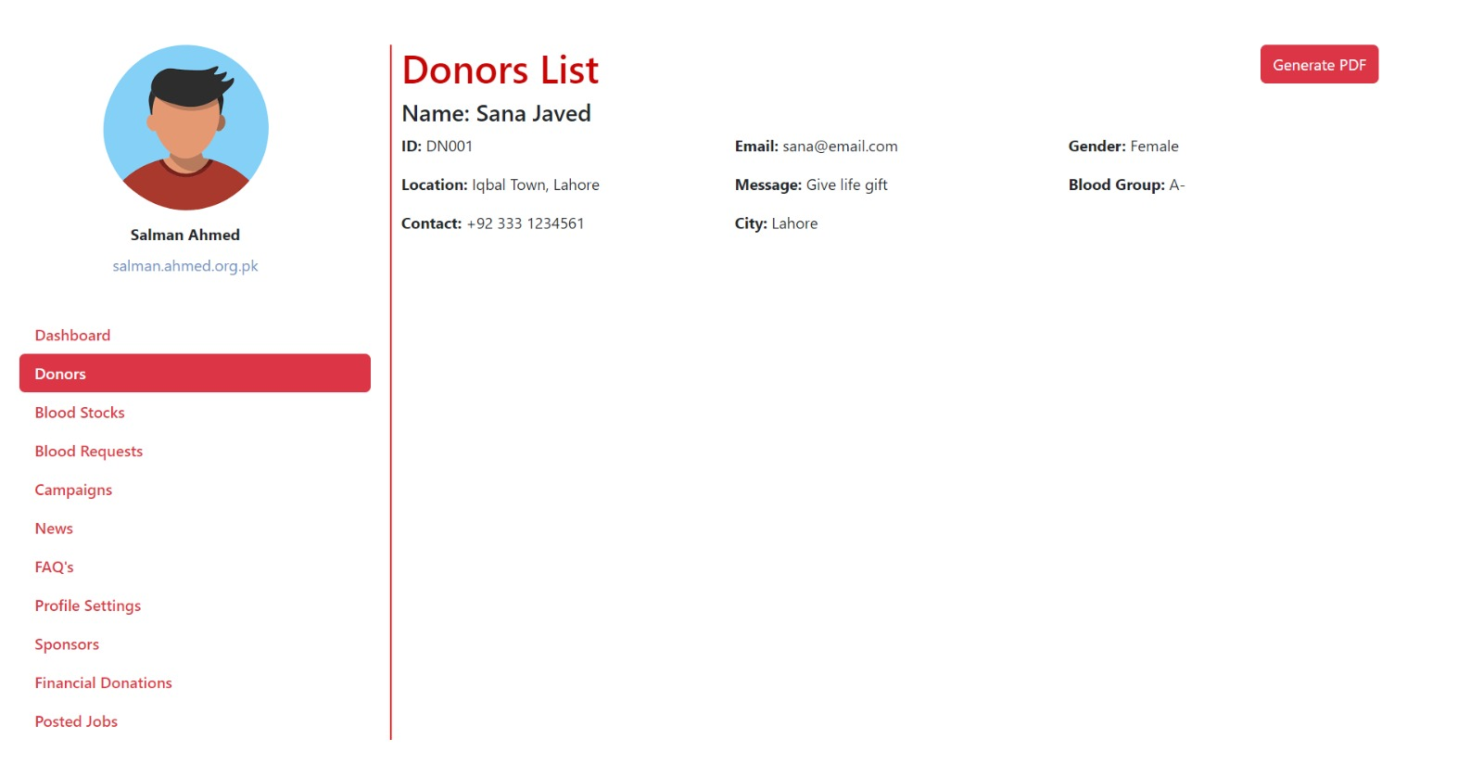
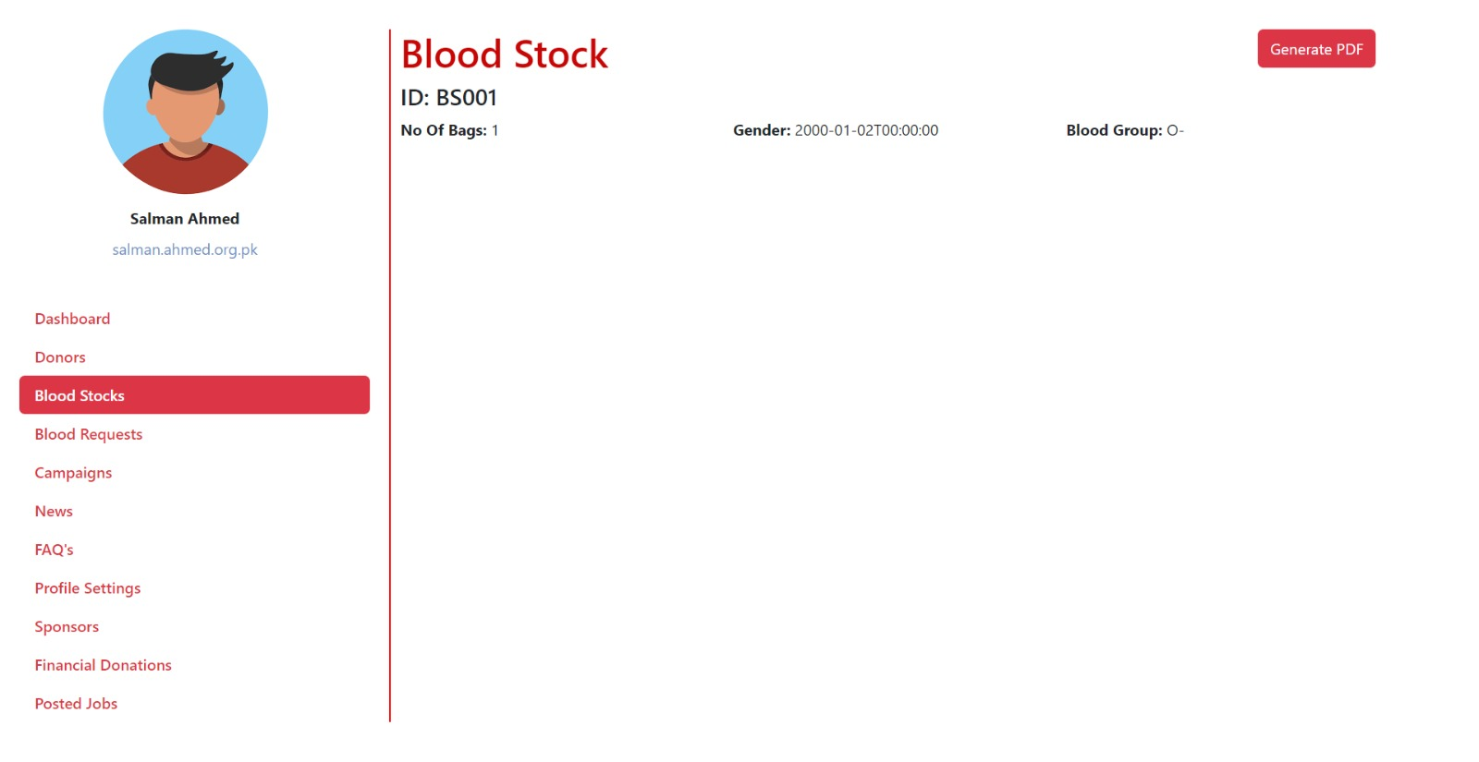
High Fidelity Prototypes
Admin Panel

Slide 21
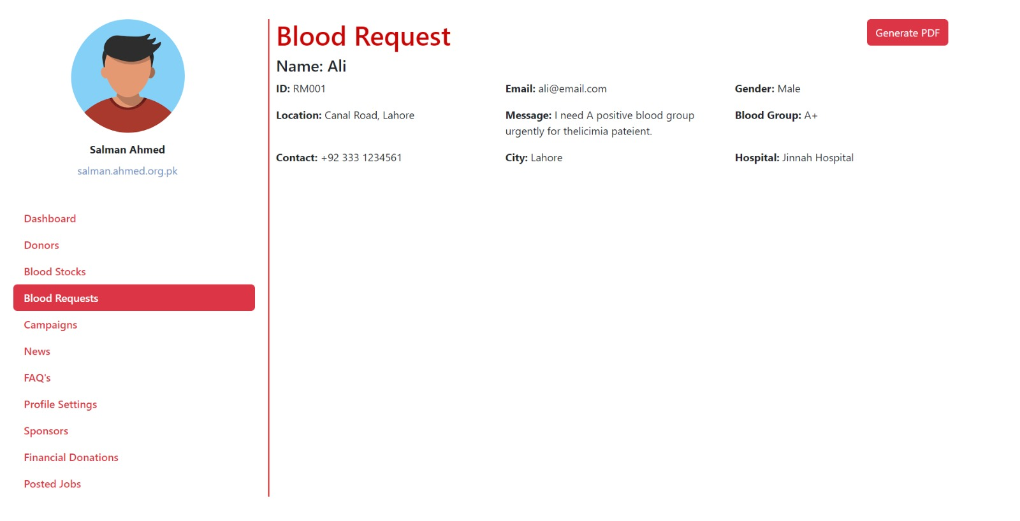
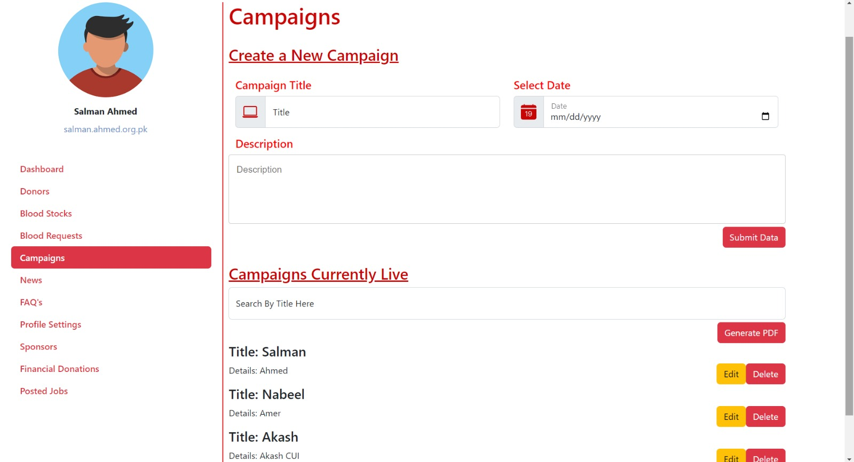
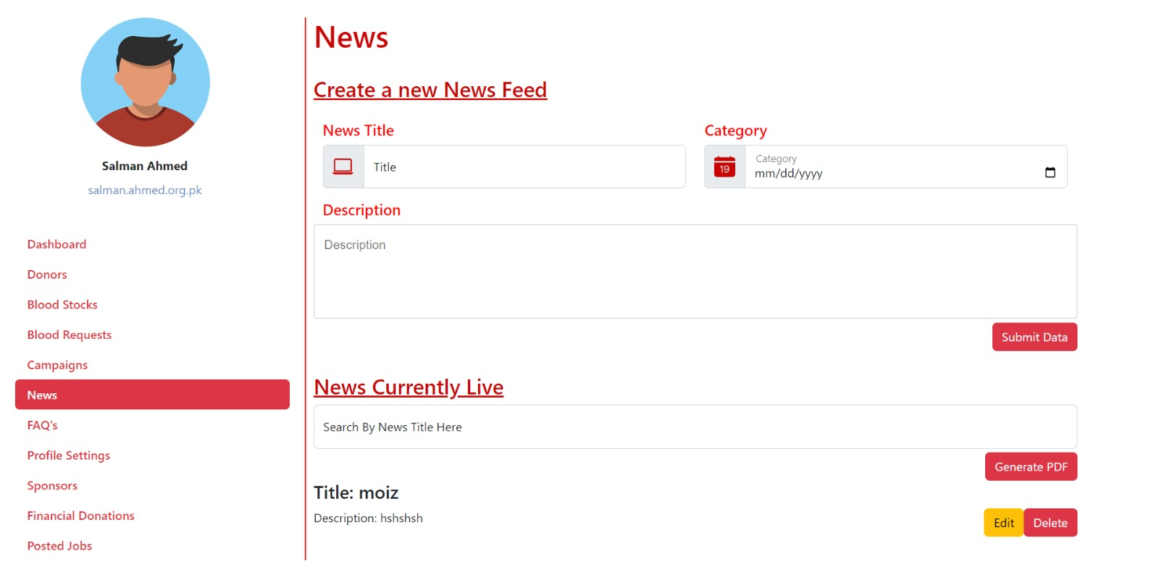
High Fidelity Prototypes
Admin Panel

Slide 22
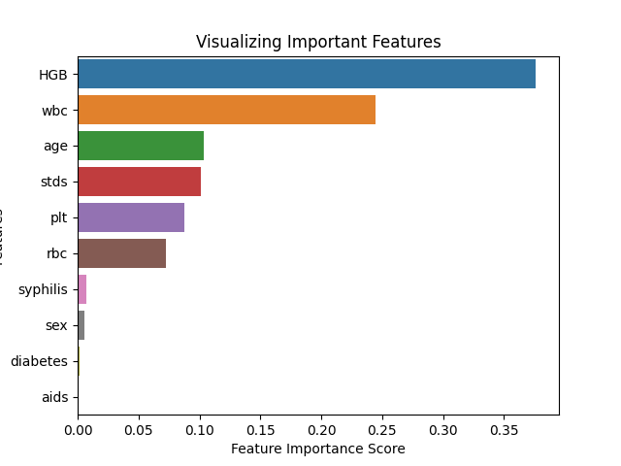
Backend Feature
Machine Learning

Slide 23
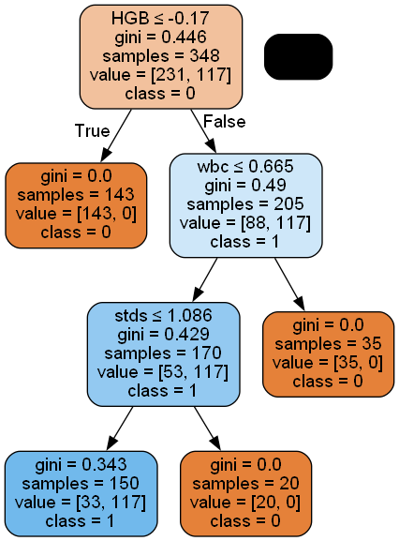
Backend Feature
Decision Tree

Slide 24
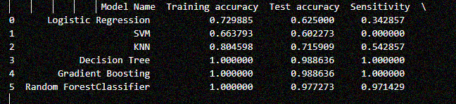
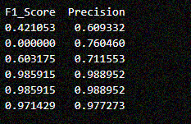
Backend Feature
Models

Slide 25
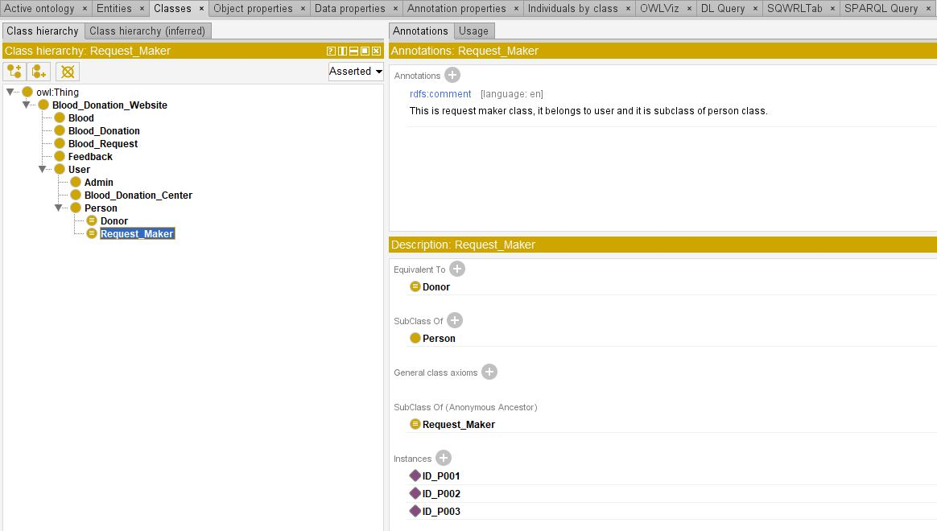
Backend Feature
Ontology Learning
Classes

Slide 26
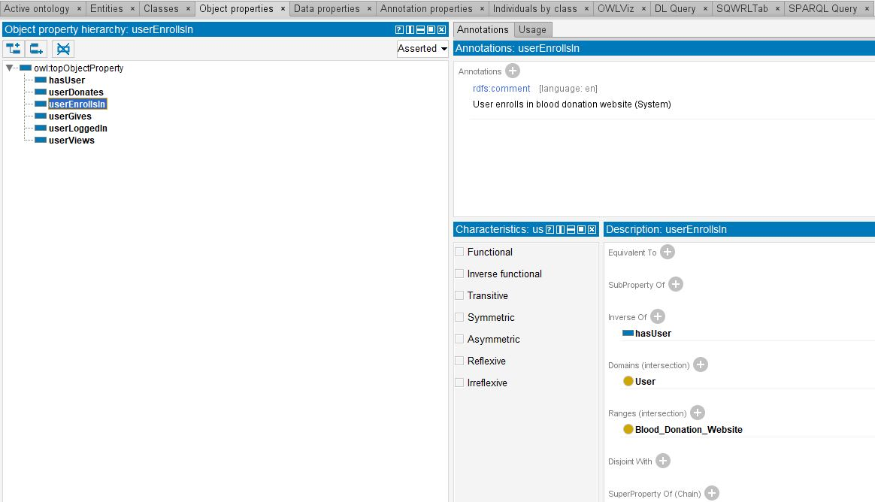
Backend Feature
Ontology Learning
Object Properties

Slide 27
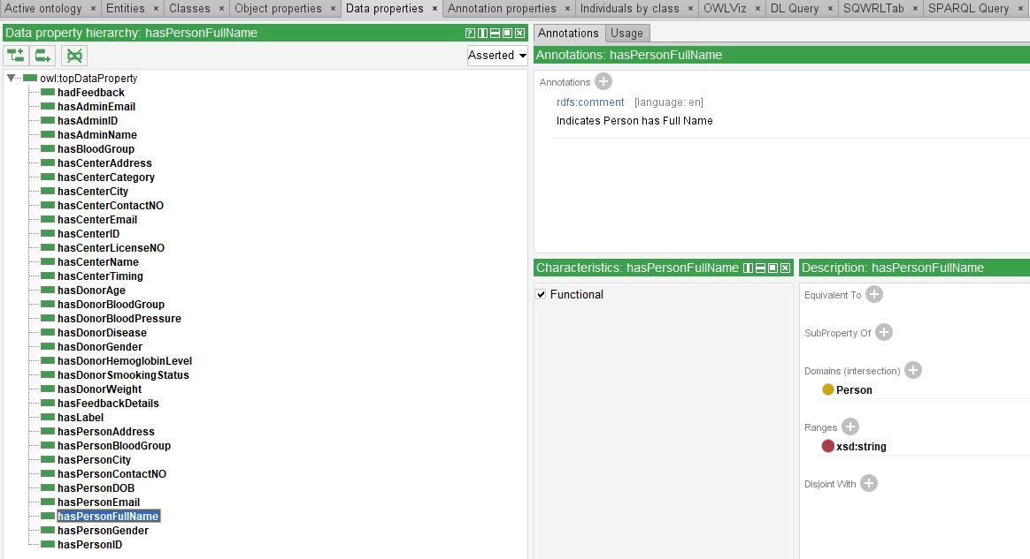
Backend Feature
Ontology Learning
Data Properties

Slide 28
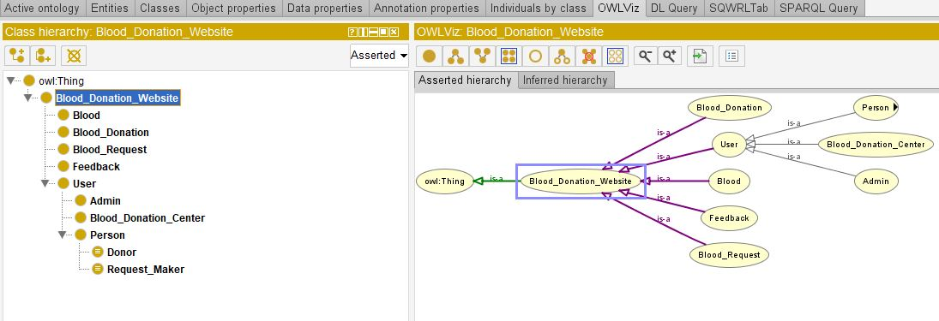
Backend Feature
Ontology Learning
OWL Viz

Slide 29
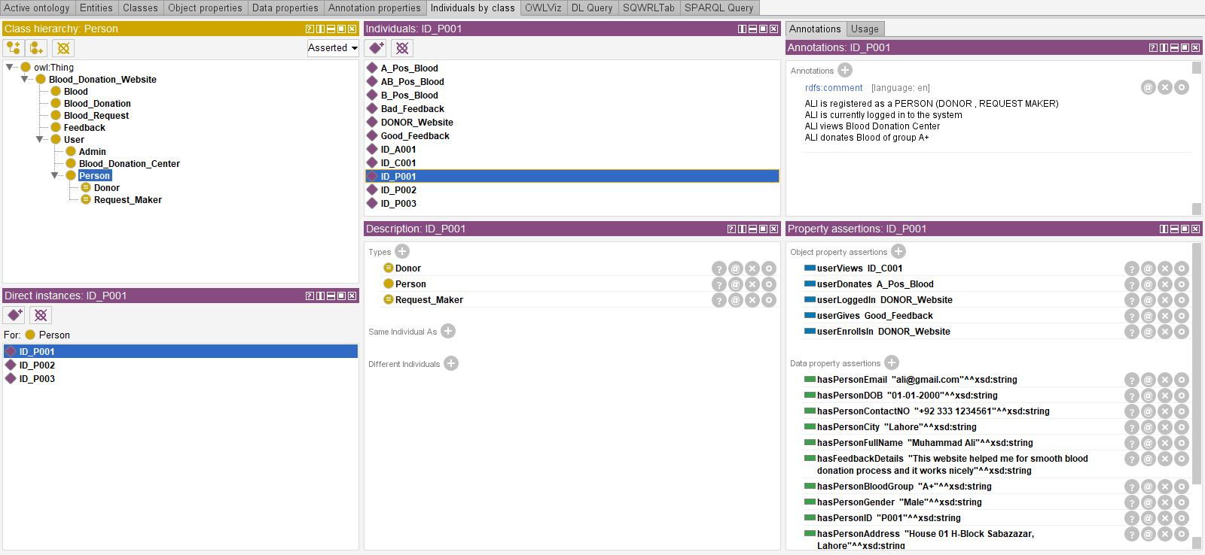
Backend Feature
Ontology Learning
Define Individuals

Slide 30
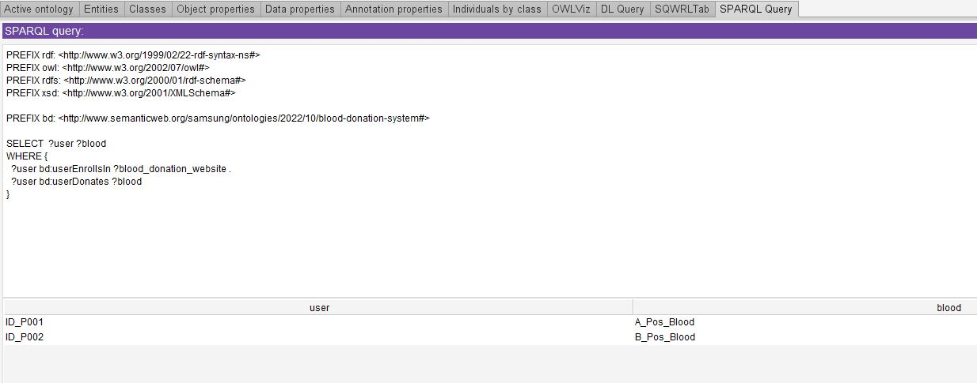
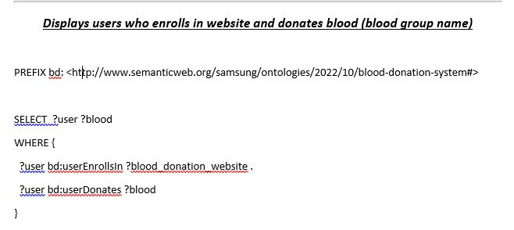
Backend Feature
Ontology Learning
Sparql Queries

Slide 31
Database Diagram

Slide 32
Conclusion
Problems faced related to prototyping of system, collection of dataset for machine learning, and making consistent ontology.
Lessons we learned are how to achieve deadlines and team coordination
Implementing the machine and ontology learning so that system can learn its own

Slide 33
Future Work
Build the Mobile application
Through machine learning and image processing, check the blood samples for donation eligibility
Add the NGO or blood donations from all over the country

Slide 34
Research Paper
Overview:
Ontologies provide us with the help of integrating data from different sources by providing a shared understanding of that particular domain. There are various languages and tools that are used in making of ontologies, we have devised a method of manual merging of the ontologies by the help of SPARQL queries for web platforms.
SPARQL (SPARQL Protocol and RDF Query Language) is a standard query language used for querying data stored in RDF (Resource Description Framework) format. In the context of ontologies, SPARQL queries can be used to retrieve information from ontologies, which are also typically stored in RDF format.
Publication Link:
https://ejsit-journal.com/index.php/ejsit/article/view/174

Slide 35
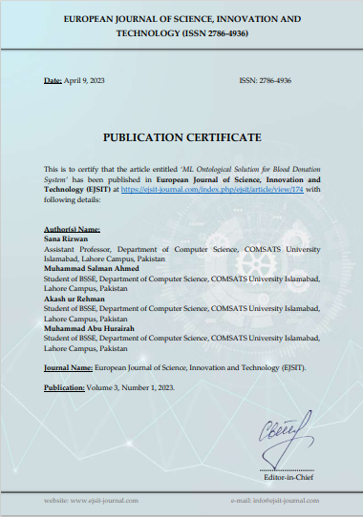
Research Paper
Publication Certificate:
Publication Link:
https://ejsit-journal.com/index.php/ejsit/article/view/174

Slide 36
References
[1] S. T. C. R. B. A. Sinha S, “Haemoglobinopathies in India: estimates of blood requirements and treatment costs for the decade 2017-2026,” Journal of community genetics, vol. 11, no. June,11, pp. 39-45, 2020.
[2] M. M. Mostafa, “ Profiling blood donors in Egypt:A neural network anaylsis, Expert system with Applications,” vol. 36, no. 2009, pp. 5031-5038, 2009.
[3] D. K. Srivastava, Utkarsh Tanwar, M.G.Krishna Rao and Priya Manohar, “A Research Paper on Blood Donation Management,” International Journal of creative research thoughts, vol. 9, no. 5 May 2021, p. 8, 2021.
[4] Dr Usman Waheed, “Knowledge, Attitude and Practices towards Blood Donation in Pakistan: A Nationwide Survey”.
[5] Dr. Muneeba Azmat, “National Blood Donor Policy (2011) Safe Blood Transfusion Programme, Ministry of National Health Services, Government of Pakistan.”
[6] Hassan Abbass Zaheer, “ Inventory of Blood Donor Organizations (2012) Safe Blood Transfusion Programme, Ministry of National Health Services, Government of Pakistan.”

